Slide 1
.NET Core µservices
From Soup to Nuts, Background

Slide 2
Agenda
Prerequisites
Cloud Native
Containers
CQRS, Brighter and Darker
Task Queues, Messaging

Slide 3
Prerequisites
What you need to follow along

Slide 4

A C# editor or IDE: Vim, Code, Rider, Visual Studio
.NET Core 2.0 https://www.microsoft.com/net/core
Docker CE: https://store.docker.com/
Git: https://git-scm.com/downloads
git clone git@github.com:BrighterCommand/FutureStack.git

Slide 5

Grab ‘em during this talk

Slide 6
Cloud Native
µservices in context

Slide 7
What is Cloud Native?

Slide 8
Perhaps we first need to ask: what do we mean by cloud?

Slide 9
“By cloud, we mean any computing environment in which computing, networking, and storage resources can be provisioned and released elastically in an on-demand, self-service manner.”
Migrating to Cloud-Native Application Architectures, Matt Stine

Slide 10
By Cloud Native we simply mean:
An application that has been designed to run in such an environment
An application that allows such an environment to be exploited.

Slide 11
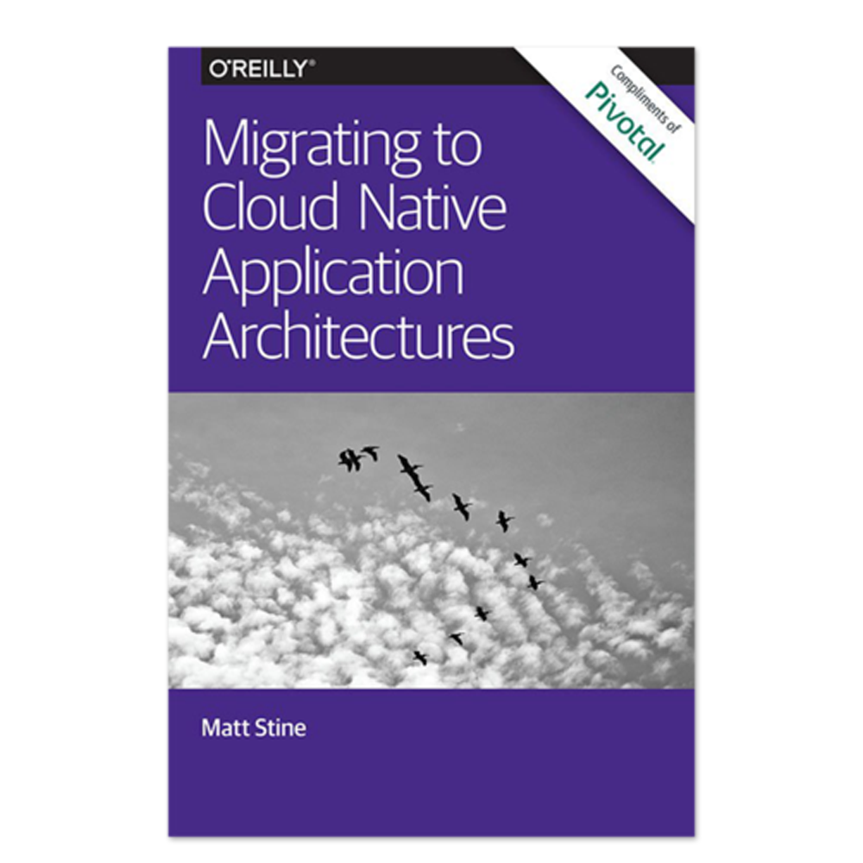
Matt Stine, author of Migrating to Cloud Native Application Architectures identifies four properties:
Properties
Speed
Safety
Scale
Client Diversity
Notes:
Speed of deployment: deployment is daily at least, not weekly, monthly or even longer
Enable RAD but still retain safety around availability and performance requirements
Ensure that we can scale horizontally
Recognize the clients are not just web, but mobile and desktop too.

Slide 12
Attributes
µservices
Twelve-Factor Apps
Self-service Agile Infrastructure
API First
Anti-fragility

Slide 13
µservices
The decomposition of monolithic business systems into independently deployable services, that do “one thing well”
Notes:
* The decomposition of monolithic business systems into independently deployable services, that do “one thing well”* Independent deployment is important to us if we want rapid delivery - we can’t wait to co-ordinate releases across teams, which is the problem with a monolith

Slide 14
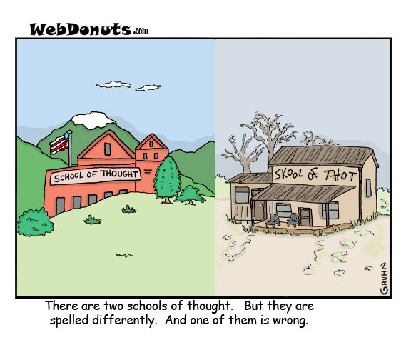
µservices
Two major schools of µservices:
SOA Derived. Fowler & Lewis via Jim Webber
Unix Pipes and Filters Derived. SOA turned up to 11 via Fred George

Slide 15
SOA Derived
SOA decomposition into Business Capabilities
Componentization via Services
Derives from SOA 4 tenets
Products not Projects
Smart endpoints and dumb pipes
Notes:
In schools of decomposition derived from SOA the decomposition tends to be based on business capabilities
A business capability is a function provided by the business, often by a department, such as Lead Generation via the Marketing department
A business capability is stable over the long term - we will always need to provide this - though the process may not be - we may do it differently
Starts with the four tenets of SOA, but then moves through “Guerilla SOA” (don’t use an ESB) to Fowler and Lewis on microservices.
Componentization via Services
Organized around Business Capabilities
Products not Projects
Smart endpoints and dumb pipes
Decentralized Governance
Decentralized Data Management
Infrastructure Automation
Design for failure
Evolutionary Design
Componentization via Services

Slide 16
Pipes and Filters Derived
Service Decomposition into ‘Filters’ that do one thing
Componentization is by “Functions As A Service”
Organized around Functions, very small i.e. sub 1K LOC
Loosely coupled pipes and filters flow
Long-lived systems, short-lived services
Multiple versions encouraged
Continuous Delivery over Unit Tests
Notes:
In schools of decomposition derived from the Unix pipes and filters approach the decomposition may be into the smallest ‘function’ that delivers business value
A function allows for highly-independent deployment as the unit of release is often the smallest unit that could work
By contrast a business capability may often ship code that is not impacted by a change
However, there is an overhead cost with decomposition, greater co-ordination is required
As such that increased flexibility over business capabilities comes at a cost.
Starts with SOA but then ‘turns the dials up to 11’; comes from Programmer Anarchy by Fred George
Pipes and Filters model: data is not stored centrally, but passed from one ‘filter’ step to another, being transformed i.e. no shared database integration, filter stores any state it needs

Slide 17
All
Decentralized Governance
Decentralized Data Management
Infrastructure Automation
Design for Failure
Evolutionary Design

Slide 18
Containers
Operating-system-level virtualization, also known as containerization, refers to an operating system feature in which the kernel allows the existence of multiple isolated user-space instances. Such instances, called containers, partitions, virtualization engines (VEs) or jails (FreeBSD jail or chroot jail), may look like real computers from the point of view of programs running in them.
https://en.wikipedia.org/wiki/Operating-system-level_virtualization

Slide 19
Hosting in IIS (Application Server)
svchost.exe
WWW Publishing Service
Modules
http.sys
w3P
Application
Pool
Notes:
This is the model we are used to: we host in IIS. IIS runs a set of worker processes (w3p) that can support an app pool (an app pool can have more than one worker process assigned – a web garden). The app pool is a unit of isolation. If one app pool fails, due to unhandled exception for example, then other app pools will be unaffected and continue to run. In addition, we maximize use of our resources. If a server has multiple cores, then we can easily support multiple app pools to exploit the capabilities of the server.
In essence we have a sandbox for our application.
Now this is not only available to the web process, but to a worker processes using WCF via Windows Activation Service that can use TCP/IP, Message Queues etc. Note how we can activate a service ‘on demand’.

Slide 20
Hosting in Docker
Docker Host
Container
Image
Container
Daemon
Notes:
Docker runs a n application in a container.
The blueprint for the container comes from an image; an image can be built up in layers – dotnet core; aspnet core; your app
Each container is ‘sandboxed’ in its use of resources on the host machine (using a Unix feature called namespaces).
The host itself is a Linux server. It may be a VM or bare metal. Windows 10 and MacOS support use of a hypervisor to provide a VM based Linux host that is transparent to the developer
A container is deployment approach for your application, just as an AppPool is, though it uses a different technology
Whereas IIS only supports either HTTP or through WAS, WCF, a container can support anything that can run in that container.
A container can be Linux, or Windows (Nano or Server Core only).
.NET Core can be run on Linux

Slide 21

Docker Registry
Image
Docker Host
Docker CLI
Image
Container
Container
docker ps
docker run
docker build
docker exec
Docker Deamon
Dockerfile
Notes:
The Docker daemon
The Docker daemon (dockerd) listens for Docker API requests and manages Docker objects such as images, containers, networks, and volumes. A daemon can also communicate with other daemons to manage Docker services.
The Docker client
The Docker client (docker) is the primary way that many Docker users interact with Docker. When you use commands such as docker run, the client sends these commands to dockerd, which carries them out. The docker command uses the Docker API. The Docker client can communicate with more than one daemon.
Docker registries
A Docker registry stores Docker images. Docker Hub and Docker Cloud are public registries that anyone can use, and Docker is configured to look for images on Docker Hub by default. You can even run your own private registry. If you use Docker Datacenter (DDC), it includes Docker Trusted Registry (DTR).
When you use the docker pull or docker run commands, the required images are pulled from your configured registry. When you use the docker push command, your image is pushed to your configured registry.

Slide 22
Dockerfile
Docker can build images automatically by reading the instructions from a Dockerfile. A Dockerfile is a text document that contains all the commands a user could call on the command line to assemble an image. Using docker build users can create an automated build that executes several command-line instructions in succession.
https://docs.docker.com/engine/reference/builder/

Slide 23
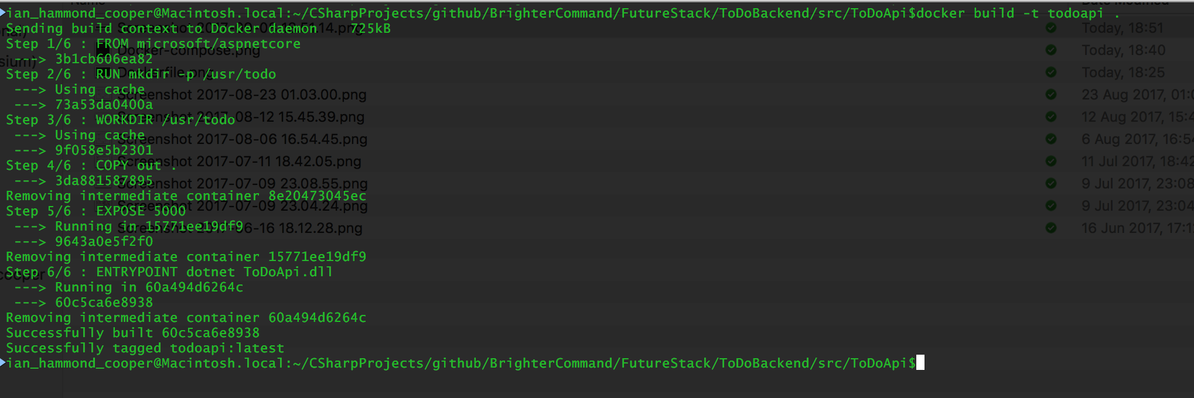
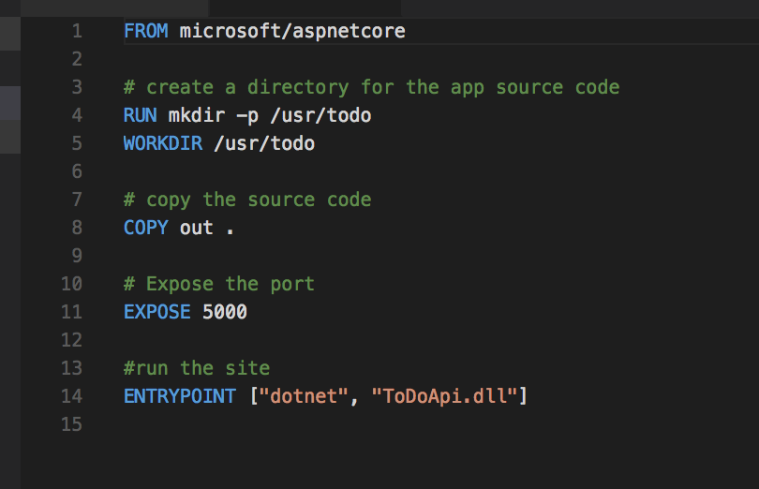
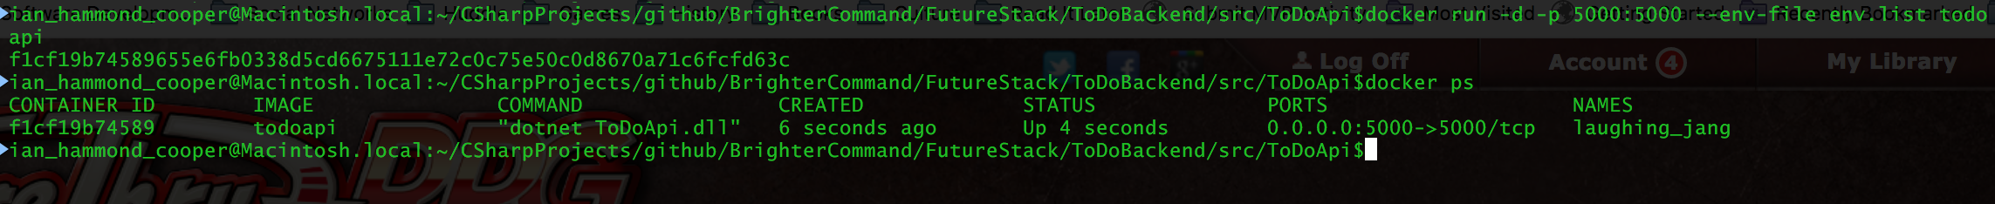
We start with a base image
We create a directory in our image to copy our code into
We have used dotnet publish to build, and then we copy to image
We use ENTRYPOINT to run the container as a process, our web app
We open a port on our container, to talk to the outside world
Notes:
A Dockerfile is a deployment to container ‘script’. It creates an image, in layers, and you can create a container from that image.
In many cases it is enough to grab a boilerplate image for running your language and runtime, deploy your code to it and set the entry point for your app
Shows that we take a base image and copy our code to it
We use Entrypoint to ‘run as an executable’, in essence we have a sandboxed process
Show running docker build –t todoapi .
-t lets us name the image
Show running docker run -d -p 5000:5000 --env-file env.list todoapi
-d is silent
-p is redirect container port to hose
--env-file lets us set environment variables

Slide 24
Docker Compose
Compose is a tool for defining and running multi-container Docker applications. With Compose, you use a Compose file to configure your application’s services. Then, using a single command, you create and start all the services from your configuration.
https://docs.docker.com/compose/overview/

Slide 25
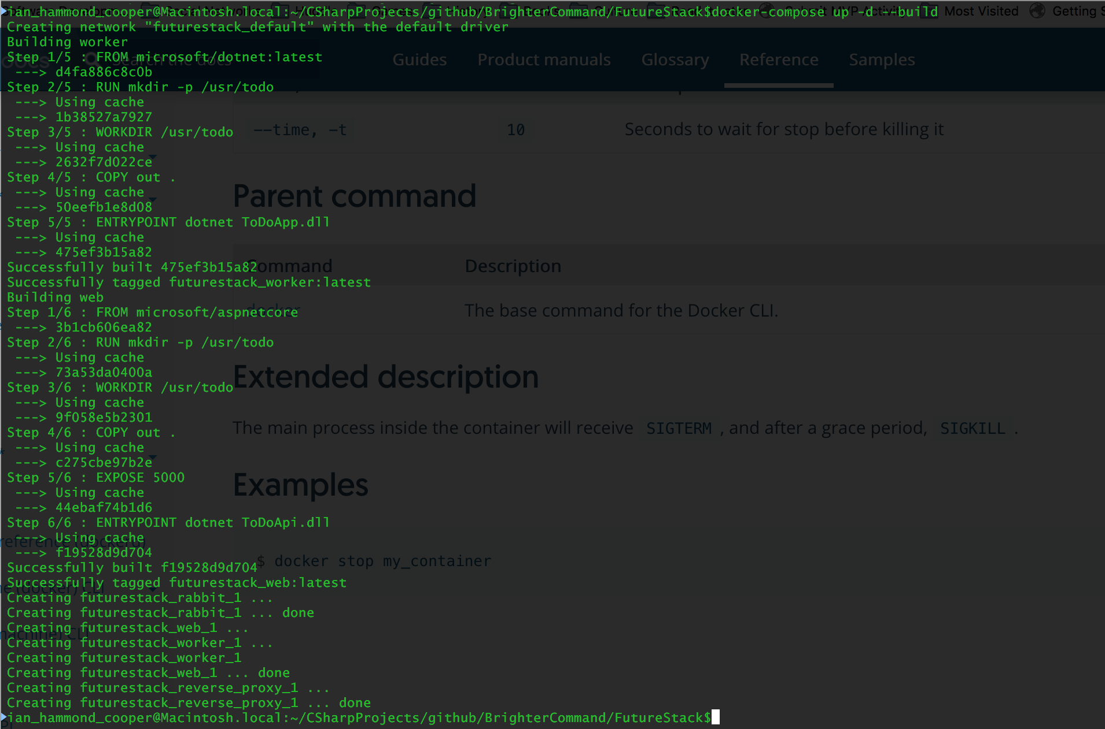
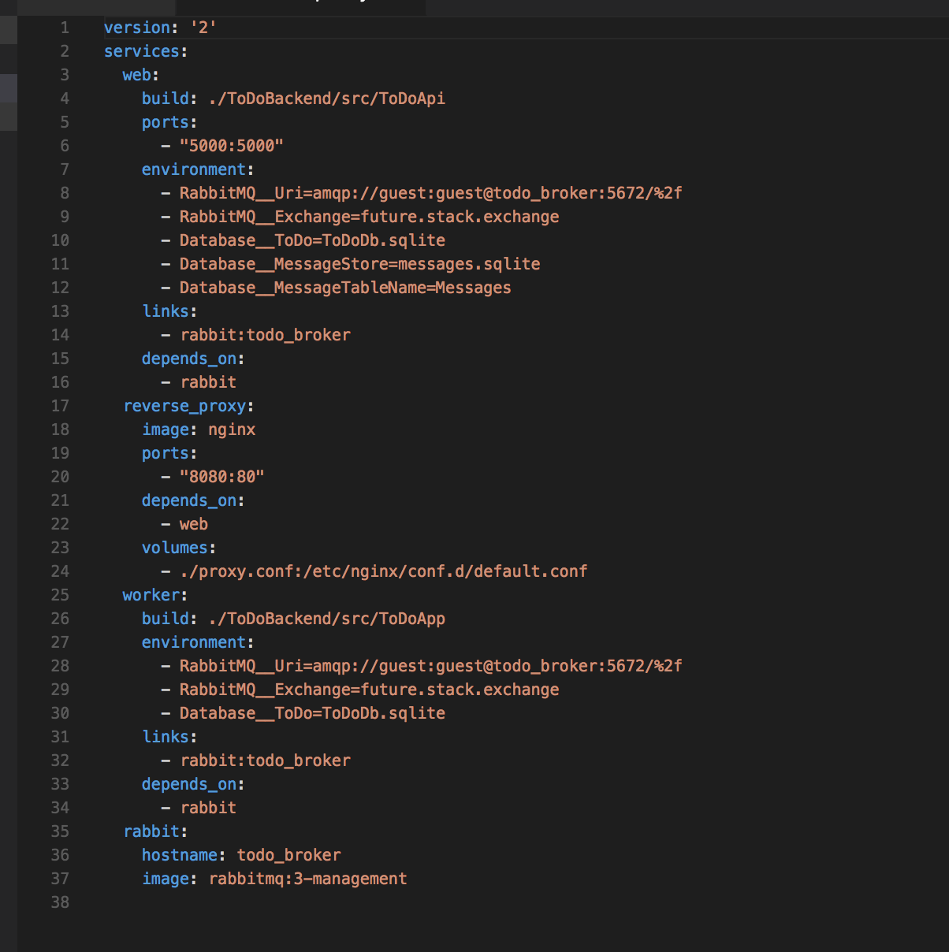
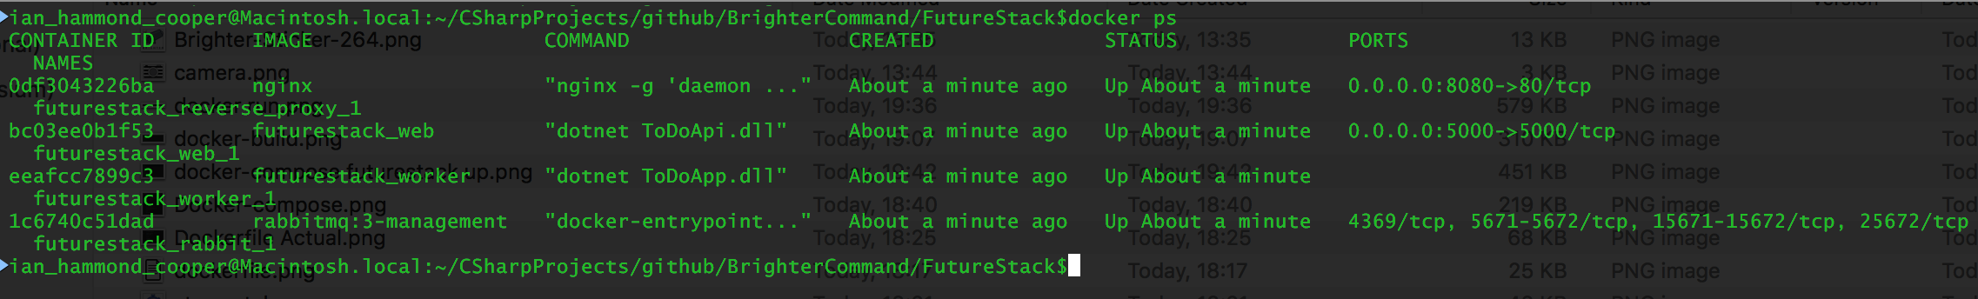
The version of compose. ‘3’ supports Swarm
Services are the set of containers that make up our application (a given service can have more than one instance)
We can remap ports on the container to ports on the host
We can set environment variables, to configure our container
A service can be built from a Dockerfile
A service can be built from an image
Use a data volume on the host for data that needs to persist
One service may depend on another
Notes:
Your application may require more than one process.
Whilst you can execute more than one process in a container, by writing a shell script to start processes that run in the background (via supervisord or the like), the benefits of process isolation and orchestration make it more sensible to run a single process per container.
But of course this introduces its own set of complexities. Service A may depend on Service B with both launched in containers. How do they locate each other, how do they wait for startup?
So how to we start multiple containers? The answer is a docker-compose file.
A compose file consists of a number of services. Where a service is just a Dockerfile or image in a registry. We can set variables for those containers when we run them, similar to the way that we can set variables via a run command, such as port or environment variables.
From version 3 on, the compose file is integrated with docker swarm, which allows us to deploy to a docker swarm

Slide 26
Swarm
A swarm is a cluster of Docker engines, or nodes, where you deploy services.
A manager node in a swarm orchestrates worker nodes
A worker node in a swarm handles application workload
Docker Swarm (standalone). Not integrated into the CLI and API
Swarmkit: Has integration to CLI and API

Slide 27
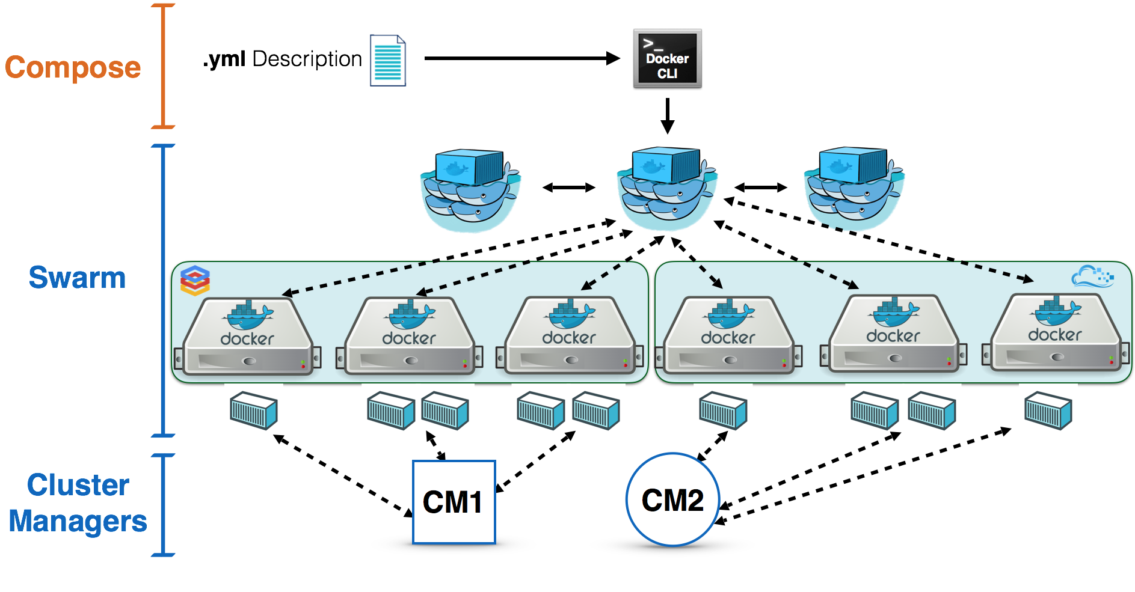
Swarm

Slide 28
CQRS
Brighter and Darker

Slide 29
Presentation
GET a page of data
Bind DTOs to view
POST change to data
Application
Query entities via ORM
Turn entities to DTOs
Query entities via ORM
Update entities
Persist changes via ORM
Domain
Turn rows to entities
Turn rows to entities
Infrastructure
DB
Notes:
Some things to talk about here:
1: The complexity cost. In order to produce a page we need to query the domain. Take an example that we have, we sell insurance and that insurance has products, so we often need to load a product list that the user can pick from. But the product aggregate in our system contains a lot of metadata so that new products can be created by end-users and not IT. It has product characteristics such as the questions we ask on your application form, pricing rules that tell us how to price that product, compliance rules to tell us who and how we can sell that product and versions because these things change. So getting a product back is expensive, our ORM pulls back many objects. But hang on, we just wanted a pick list. We just wanted a list of product names. So our ORM is hurting us, because its bringing too much back. That’s ok we say, we can lazy load beyond a certain depth. But, ok, hang on, now when we are doing pricing we get a select n+1 problem because we need all those rules. OK what did Udi and Ayende say about aggregate roots as roles and mapping an interface to a query strategy I can use that. I can call a different query every time I load. Oh hang on I need to use multi-query – wasn’t this ORM stuff supposed to help us…
2: Now I don’t want to couple my view to the model, that’s bad it means I can’t change the model without changing all the views. So I’ll have a data structure, a view model for the view. Oh wait, my domain model is a different shape. Sure I lazy loaded my product, but my viewmodel just has Id and Description. Oh no, I have to write all these ToView methods, and I get multiple ones because different views have different shapes. Automapper, Automapper can save me.

Slide 30
Presentation
GET data for view
Thin Read
Application
Populate View-Model
Domain
Infrastructure
DB

Slide 31
Presentation
POST command
Thin Read
Application
Call method on domain
Get Aggregate
Domain
Infrastructure
DB

Slide 32
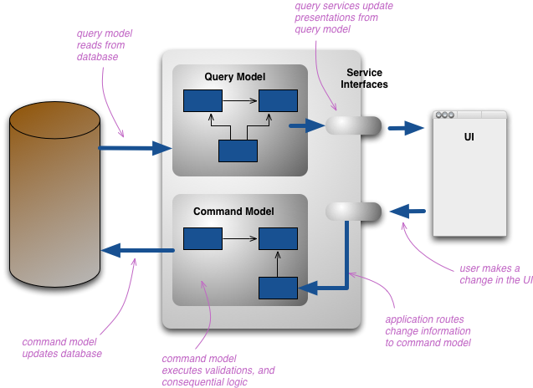
Command Query Separation
Components are query-side components or command-side components.
Only command-side components can update a repository, query-side components just read from it.
Commonly the command-side components are a domain model, though other styles such as procedural are not forbidden.
The query-side components might be elevated to a domain model, but are normally just procedural.
Martin Fowler, http://martinfowler.com/bliki/CQRS.html
Notes:
Components are either query-side components or command-side components.
The path of a request through the system only passes through command-side or query-side components depending on whether it is querying or modifying the state of the system.
Only command-side components can update a repository, query-side components just read from it.
Commands and queries are usually explicit components on their respective sides.
Both the command-side and the query-side are layered, but there are usually far fewer layers on the query-side.
Commonly the command-side components are a domain model, though other styles such as procedural are not forbidden.
The query-side components might be elevated to a domain model, but are normally just procedural.

Slide 33
Task
Command
Notes:
A user carries out a task.
The task maps naturally to a command within the system,. A command:
Decouples the caller from the domain model’s implementation of the command
Is reusable
Forms a transactional boundary

Slide 34
Query
Task
Command
Notes:
In CQRS terms we can view both a Command and a Query as instances of the Command pattern.
They both separate the caller from the implementation details, are reusable, and are transactional units

Slide 35
Query
Task
Handler
Command
Notes:
We can use a handler to separate a query or command into:
Parameters: The Query or Command is a data structure that contains the ‘parameters’ of the call i.e. what varies
Handler: The Handler is the implementation, how do we perform the task using these parameters
This decouples the sender from the receiver by removing routing knowledge from the sender.
We call this a Command Dispatcher.
We can now swap handlers when we want to vary implementation (for example for feature switching)

Slide 36
Query
Task
Handler
Handler
Command
Notes:
Once we move to a dispatcher model, it is possible to use a pipeline model. The additional handlers are for orthogonal concerns such as logging, availability etc.

Slide 37



Slide 38
Messaging
Task Queues and Events

Slide 39
µservices Communication
Client
127.0.0.1/api/serviceB
127.0.0.1/api/serviceA
Service A
Service B
[{“City”: “Paris”}]
ASP.NETWeb API
ASP.NETWeb API
GET
PUT
POST
DELETE
PATCH
Http Client Lib
Notes:
Because a mservice has to communicate outside the data centre, using a sychronous protocol (client blocks waiting for a response) it is common for a server to expose an HTTP + JSON API (REST) to communicate with a client.
As we have exposed this API, it would seem to make sense for other services to use the same API to communicate with the mservice.
Indeed this is a very common pattern.
However, the HTTP + JSON API has two weakenesses, temporal and behavioral coupling

Slide 40
Temporal Coupling: The property that two or more components must be available at the same time to satisfy a request.
Behavioral Coupling: The property that the caller determines what to do, and also knows something of how the receiver will satisfy the request

Slide 41
µservices Communication
[{“City”: “Paris”}]
Client
GET
PUT
POST
DELETE
PATCH
127.0.0.1/api/serviceB
127.0.0.1/api/serviceA
Service A
Service B
ASP.NETWeb API
ASP.NETWeb API
Producer Library
Channel
Consumer Library
Notes:
Messaging allows us to avoid the problems of temporal coupling
A message uses Message Oriented Middleware to guarantee delivery of a message between two services instead.
A producer puts a message onto a channel, and a consumer reads messages from the channel
We scale up, by increasing the number of consumers (generally read messages from the channel, faster than they arrive).

Slide 42
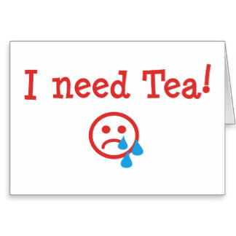

A Command
An Event
Notes:
What about behavioral coupling?
A message does not suggest how to process it’s request. It just says process this intent.
But, a command states the type of response, so it implies that the producer knows of the consumer’s existence and its capabilities, so there is still behavioral coupling (if light).
We may prefer and event to a command when integrating.
A Command says: Do this thing i.e. Make me a cup of tea. This works if the client is there, I will get a cup of tea, but if the client is not I must have used some middleware in the runtime to guarantee at least once delivery. You might also refuse me, perhaps you are busy.
An Event says: Here is the state I am in. Can you help? We are open here to anyone handling it. I don’t care who gets me tea, I just want tea. Some potential tea bringers may be busy, but another one might bring me tea.

Slide 43
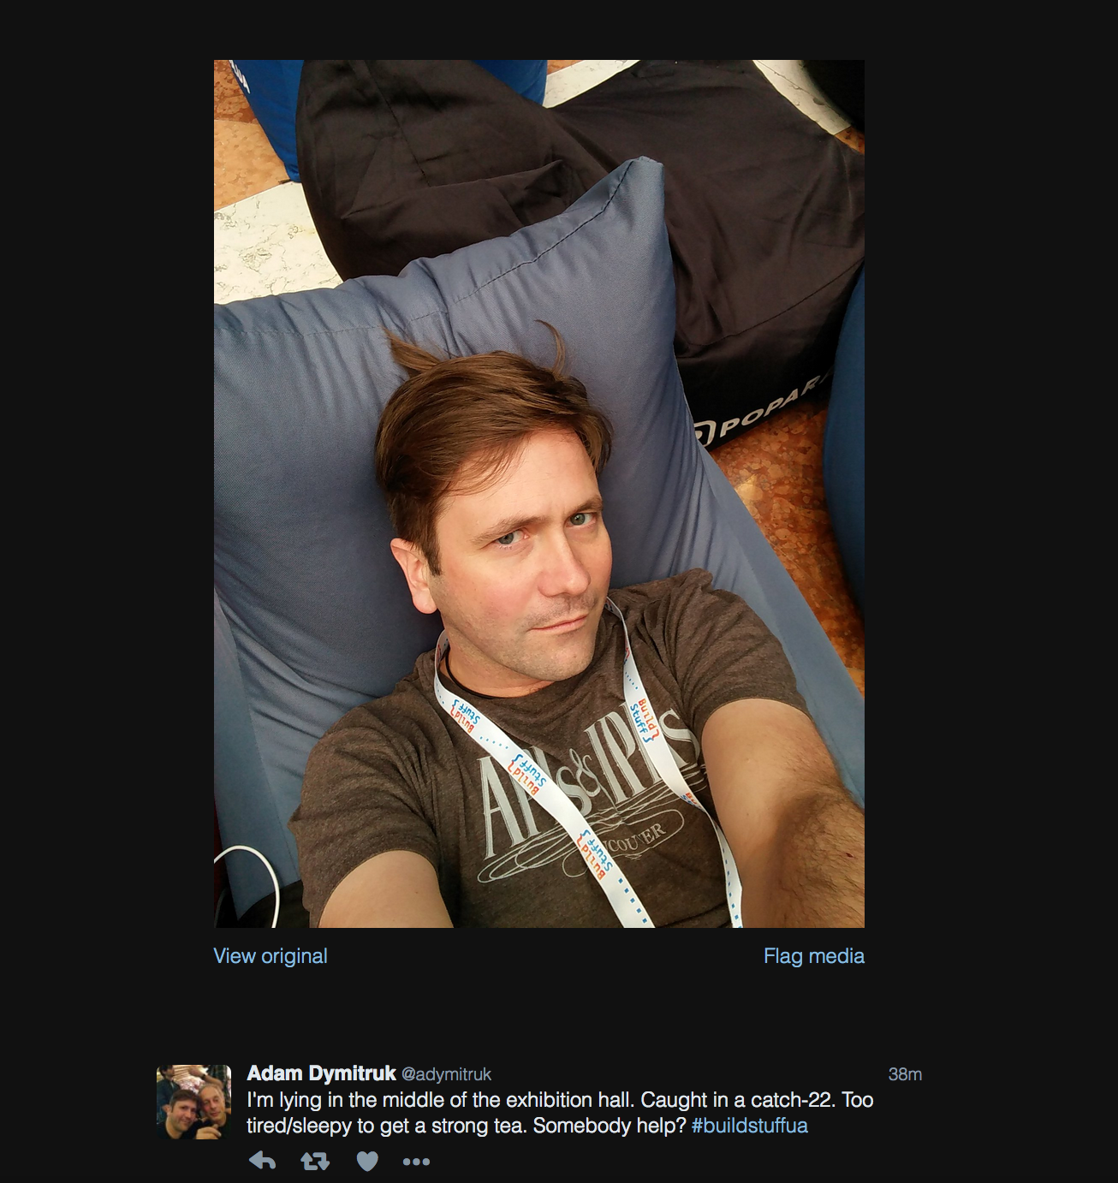

Slide 44
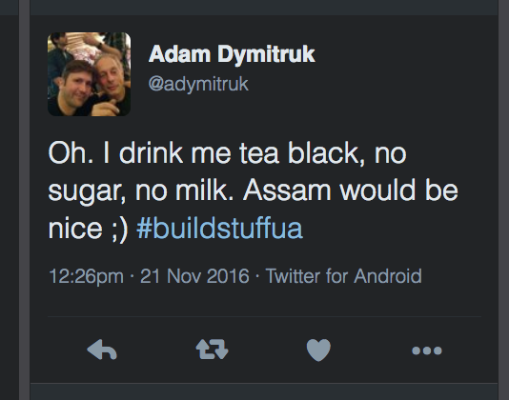

Slide 45
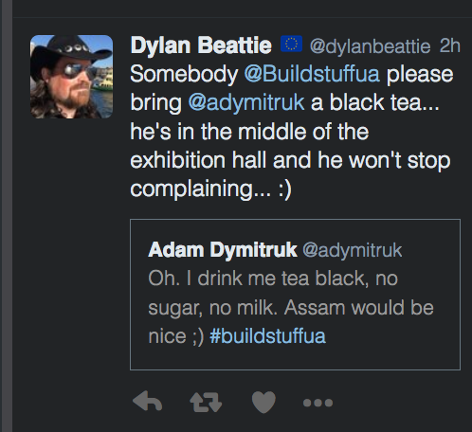

Slide 46
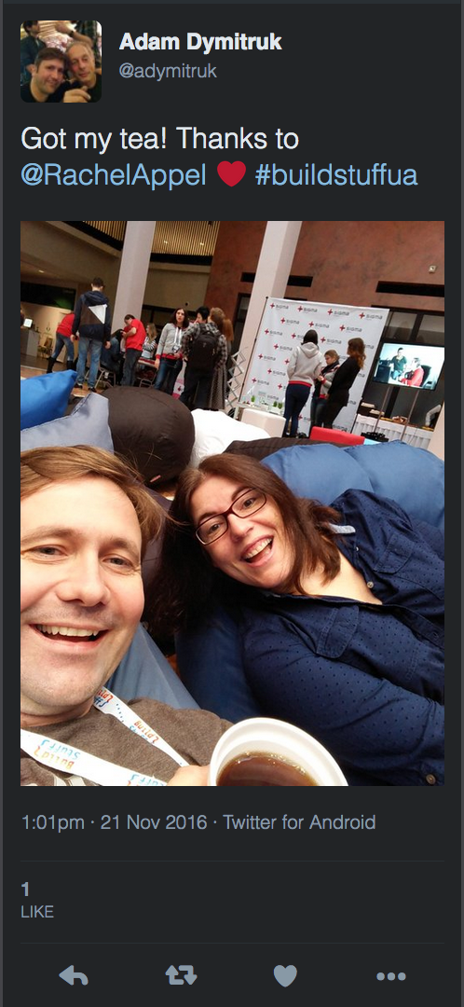

Slide 47
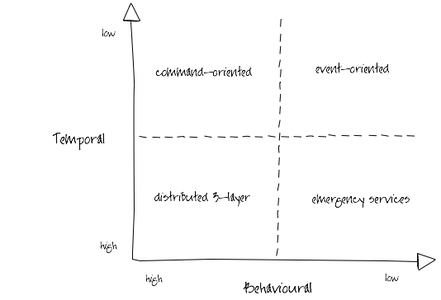
Ian Robinson: http://iansrobinson.com/2009/04/27/temporal-and-behavioural-coupling/
Notes:
Distributed 3-layer
Traditional 3-layer application architecture blown up to distributed proportions. Characterized by call stack-like, imperative behaviour (high temporal and behavioural coupling) and synchronous request-response interactions. Includes systems that layer synchronous interactions on top of asynchronous message exchanges. Senders tell receivers what to do; receivers execute the sender’s orders. Sender and all intermediaries block until the call stack unwinds, effectively locking and/or consuming system resources further up the call chain. This blocking behaviour undermines the autonomy of upstream components and at the same time increases the availability requirements of downstream components. As Michael Nygard’s Release It! reminds us, in these circumstances the availability of the overall system can be no more than that of the least available participant, and the probability of failure is the joint probability of failure in any component or service.
Command-oriented
“Good”, “orthodox” SOA. Low degree of temporal coupling characterised by asynchronous interactions, deferred state and a resumable programming model (process or activity instances are dehydrated between remote invocations in order to conserve resources, and then rehydrated based on correlated responses). Senders typically determine what needs to be done, but rely on receivers to determine how to execute their instructions. This behavioural coupling can require providers to evolve (message formats, supported operations) in lockstep with changing consumer demands.
Event-oriented
Low temporal and behavioural coupling. Receivers determine both what needs to be done and how to do it based on the content of received messages. Resumable programming model: processes are suspended or dehydrated, waiting for events. Can be difficult to trace the execution path of an end-to-end transaction or activity. Exposing an ExtinguishFire operation is a command-oriented way of executing a business process; acting on FireStarted notifications an event-oriented approach.
Emergency services
So called because you tell them what happened, and they decide what to do, but if there’s no one to take your call, you’re hosed. Low behavioural coupling, which allows for the independent evolution of system components, but a degree of temporal coupling, impacting availability requirements of participants. Many RESTful solutions occupy this quadrant. URI-templated solutions have a higher degree of behavioural coupling than hypermedia-driven solutions (where servers constrain and guide what a client can do next, and determine how best to satisfy requests); client polling and caching can mitigate some of these temporal coupling issues.

Slide 48
Task Queues
A system for parallel execution of discrete tasks in a non-blocking fashion
Avoid doing resource intensive work, now, and having to wait
We encapsulate the task as a message and put it onto a queue
A worker process pops the message of the queue and executes the task, eventually
We can run many workers and distribute the work amongst them

Slide 49
A messaging framework can be used to implement a task queue
Worker A
127.0.0.1/api/serviceA
Web App
Consumer Library
ASP.NETWeb API
127.0.0.1/api/serviceA
Producer Library
Channel
Worker B
Consumer Library

Slide 50
Q&A

